Slide 1

Operating systems
Lecture # 01

Slide 2
Lecture Overview
Course Objectives
Overview of Operating Systems (OS)
Abstract Representation of System
Core Components of an Operating
Key Functions of an Operating System

Slide 3
Objectives!
To learn the fundamentals of Operating Systems.
To learn the mechanisms of OS to handle processes and threads and their communication.
To learn the mechanisms involved in memory management in contemporary OS.
To gain knowledge on distributed operating system concepts that includes architecture.
Mutual exclusion algorithms, deadlock detection algorithms and agreement protocols.
To know the components and management aspects of concurrency management.

Slide 4
Simple Words!
An Operating System (OS) is a software that acts as a bridge between the user and the computer hardware. It manages all the computer’s resources — such as memory, processor, storage, and devices — and allows users and programs to run smoothly. - Silberschatz, A., Galvin, P. B., & Gagne, G. (2018).
OR
An operating System is a collection of system programs that together control the operations of a computer system. Some examples of operating systems are Windows, Linux, Ubuntu, MacOS X / iOS, and Android.
Questions?
- History (Windows 71.7%, Linux 4.04%, MacOS 15.7%)
Why do we need OS?
Primary Goal of OS?
- How can one interact with hardware without OS?

Slide 5
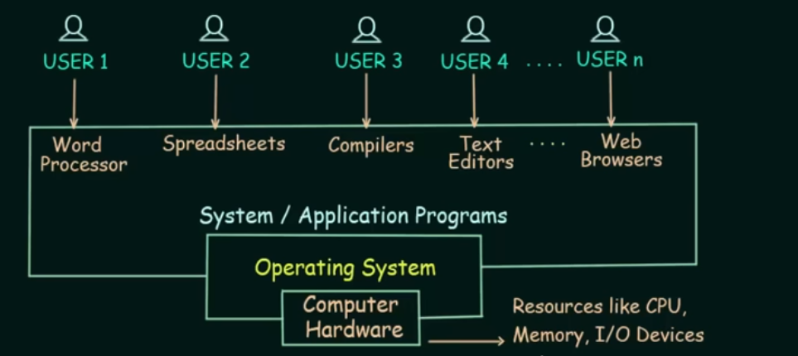
Abstract View of System Components
Hardware – provides basic computing resources (CPU, memory, I/O devices).
Operating system – controls and coordinates the use of the hardware among the various application programs for the various users.
Application / System programs – Define the ways in which the system resources are used to solve the computing problems of the users (compilers, database systems, video games, business programs).
Users (people, machines, other computers).

Slide 6
Components of OS
- OS has two parts. Kernel & Shell.
Kernel is an active part of an OS i.e., it is the part of OS running at all times. It is a programs which can interact with the hardware. Ex: Device driver, dell files, system files etc.
Shell is called as the command interpreter. It is a set of programs used to interact with the application programs. It is responsible for execution of instructions given to OS (called commands).
- Operating systems can be explored from two viewpoints: the user and the system.
User View: From the user’s point view, the OS is designed for one user to monopolize its resources, to maximize the work that the user is performing and for ease of use.
System View: From the computer's point of view, an operating system is a control program that manages the execution of user programs to prevent errors and improper use of the computer. It is concerned with the operation and control of I/O devices.

Slide 7
Functions of an os
Process Management
The OS handles the creation, scheduling, and termination of processes.
It ensures each running program gets sufficient CPU time and runs efficiently without interfering with others.
Responsibilities include:
Process creation and deletion
CPU scheduling (deciding which process runs next)
Synchronization and communication between processes
Deadlock handling
Example: When you open multiple apps, the OS allocates CPU time to each using scheduling algorithms (e.g., Round Robin, FCFS).

Slide 8
Functions of an os
2. Memory Management
Manages the computer’s main memory (RAM).
Keeps track of which part of memory is in use and by which process.
Allocates and deallocates memory as needed.
Supports virtual memory (using hard disk space as temporary RAM).
Example: When running multiple apps, OS ensures each gets separate memory space to avoid data overlap.

Slide 9
Functions of an os
2. Memory Management
Manages the computer’s main memory (RAM).
Keeps track of which part of memory is in use and by which process.
Allocates and deallocates memory as needed.
Supports virtual memory (using hard disk space as temporary RAM).
Example: When running multiple apps, OS ensures each gets separate memory space to avoid data overlap.
Questions?
RAM VS ROM? Volatile/Non-Volatile
Primary VS Secondary Memory?
What happens when RAM is full?
What is Virtual Memory?
Physical Memory VS Virtual Memory?

Slide 10
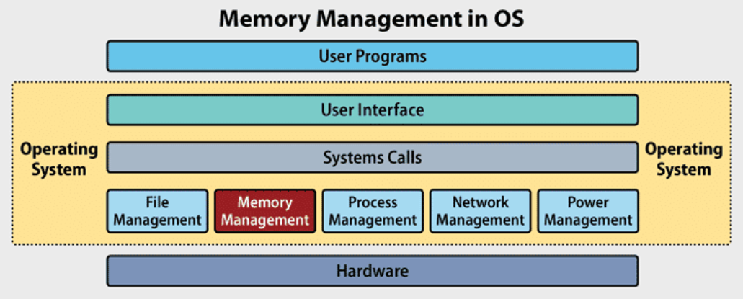

Slide 11
Functions of an os
3. File Management
Organizes and controls data storage and access on storage devices.
Maintains file system structure, file naming, access permissions, and directories.
Responsibilities include:
Creating, deleting, reading, and writing files
Managing directories and paths
Handling file permissions and protection
Example: When saving a Word document, the OS decides where and how it’s stored on the disk.
Some useful Abbreviations: FAT, NTFS, NFS, FTP, SSD, and HDD

Slide 12
Functions of an os
4. Device Management (I/O Management)
Controls input/output (I/O) devices like keyboards, printers, disks, and monitors.
Uses device drivers to communicate between hardware and software.
Ensures efficient data transfer between CPU and devices.
Example: When you print a document, the OS’s printer driver handles communication with the printer.
Example Analogy:
“Think of the OS as a traffic controller — it directs data between the CPU, memory, and devices so that there’s no collision.”

Slide 13
Functions of an os
5. Storage Management
Storage Management is the process by which the Operating System (OS) controls how data is stored, organized, retrieved, and maintained on secondary storage devices (like HDDs, SSDs, USB drives, etc.).
Key Responsibilities of the OS
Space Allocation
Free Space Management
Disk Scheduling
Common algorithms:
FCFS (First Come First Serve)
SSTF (Shortest Seek Time First)
SCAN (Elevator Algorithm)
Data Integrity: Ensures that data remains accurate and uncorrupted.
Caching & Buffering: Temporarily stores frequently used data in cache memory for faster access.

Slide 14
Memory Management vs. Storage Management
Feature / Aspect | Memory Management | Storage Management
Definition | Manages the main memory (RAM) used during program execution. | Manages secondary storage like hard drives, SSDs, and external storage.
Type of Memory | Volatile memory (data is lost when power is off). | Non-volatile memory (data is retained after power off).
Purpose | Allocates and deallocates memory to running processes. | Allocates and tracks space for file storage on disks.
Handled By | Memory Manager (part of OS kernel). | File System & Storage Manager.
Speed | Very fast (nanoseconds). | Slower (milliseconds) compared to RAM.
Data Lifetime | Temporary — used while program runs. | Permanent — stored until deleted.
Main Tasks | - Allocate memory to processes - Track memory usage - Provide virtual memory - Prevent overlap between processes | - Manage disk blocks/sectors - Handle file system - Maintain data integrity - Perform disk scheduling
Example | Running multiple apps — OS gives each process its own memory space. | Saving a Word file — OS decides where it’s stored on the hard drive.
Unit of Management | Pages / Frames | Blocks / Sectors
Error Example | “Out of Memory” | “Disk Full”
Question?
Why does SSD perform faster than HDD?

Slide 15
Functions of an os
6. Security and Protection
Protects system resources and data from unauthorized access or misuse.
Implements user authentication (login/password) and access control.
Provides encryption, firewalls, and permissions for files and devices.
Example: OS prevents one user from accessing another’s files without permission.
Key Functions of Security & Protection
User Authentication: Username/Password, Biometric login, Smart cards, 2FA (Two-Factor Authentication).
Access Control: Uses Access Control Lists (ACLs) or role-based permissions.
Encryption: Converts data into unreadable format to prevent theft or tampering- (HTTPS).
Firewalls & Network Protection: Helps block unauthorized access or malicious traffic.
File & Device Permissions: Prevents one user from accessing another’s private data.
Audit & Logging: Records system activities and user actions for monitoring and investigation

Slide 16
Functions of an os
7. User Interface (UI) Management
Provides an interface for users to interact with the system.
Types of interfaces:
Command-Line Interface (CLI) (e.g., Linux terminal)
Graphical User Interface (GUI) (e.g., Windows desktop)
Examples
Windows File Explorer — lets you open, copy, or move files visually.
macOS Finder — helps you browse and manage applications and files.
Linux Terminal — lets you execute system-level commands using text.
Questions?
Why do some programmers still prefer CLI over GUI?
Which interface type is best for beginners?
What makes an interface user-friendly?

Slide 17
Why do some programmers still prefer CLI over GUI?
🖋️ Command-Line Interface (CLI)
- Text-based commands - Requires technical knowledge - Faster and efficient for advanced users Example: Linux Terminal, Windows CMD
🖱️ Graphical User Interface (GUI)
- Visual interaction using icons & menus - Easy to learn & use - Common for beginners Example: Windows Desktop, macOS Finder
💡 Fun Fact: The first GUI-based OS was Xerox Alto (1973), which inspired Apple and Microsoft!

Slide 18
Functions of an os
8. Networking Management
Manages network connections, data transmission, and resource sharing between systems.
Handles TCP/IP protocols, network drivers, and security measures.
Example: The OS allows file sharing or internet access between multiple connected computers
9. Error Detection and Handling
Detects system errors (hardware failure, memory overflow, invalid operations).
Takes corrective actions — alerts user, logs event, or restarts process.
Ensures smooth system operation without crashes.
Example: Windows shows an error dialog if a program stops responding.

Slide 19
10. System Performance Monitoring
Tracks CPU, memory, and I/O usage for performance optimization.
Tools like Task Manager (Windows) or top (Linux) show real-time statistics.
Helps in resource planning and detecting bottlenecks.
Metric | Description | Example Tools
CPU Usage | Monitors how much processing power is being used. | Task Manager (Windows), top (Linux)
Memory Usage | Tracks available and used RAM. | Resource Monitor, free -m
Disk I/O | Measures read/write operations on storage devices. | Disk Management tools
Network Activity | Monitors data sent and received over the network. | netstat, Wireshark
Processes | Lists active tasks and their resource usage. | Task Manager, ps command

Slide 20
Thank you!
“Every expert was once a beginner — keep exploring how systems really work!”

